Slide 1

Connected World.
Connected Experiences.

Slide 2

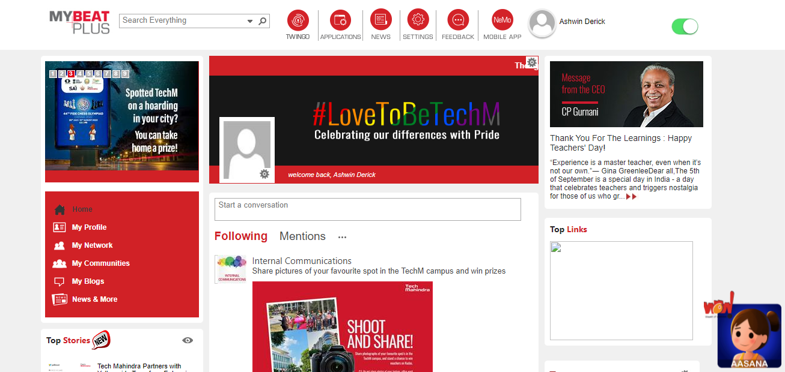
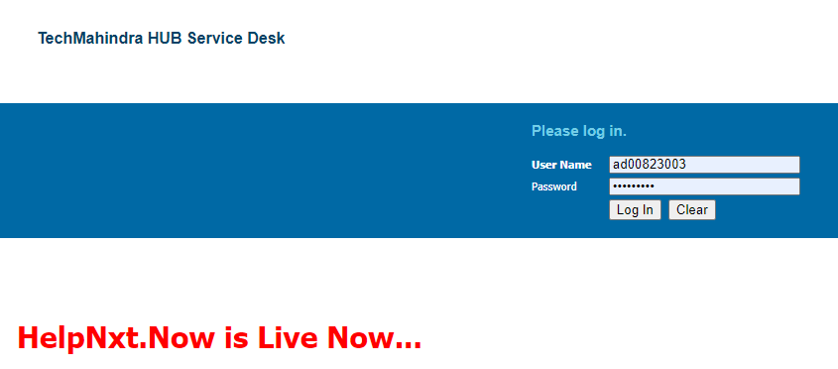
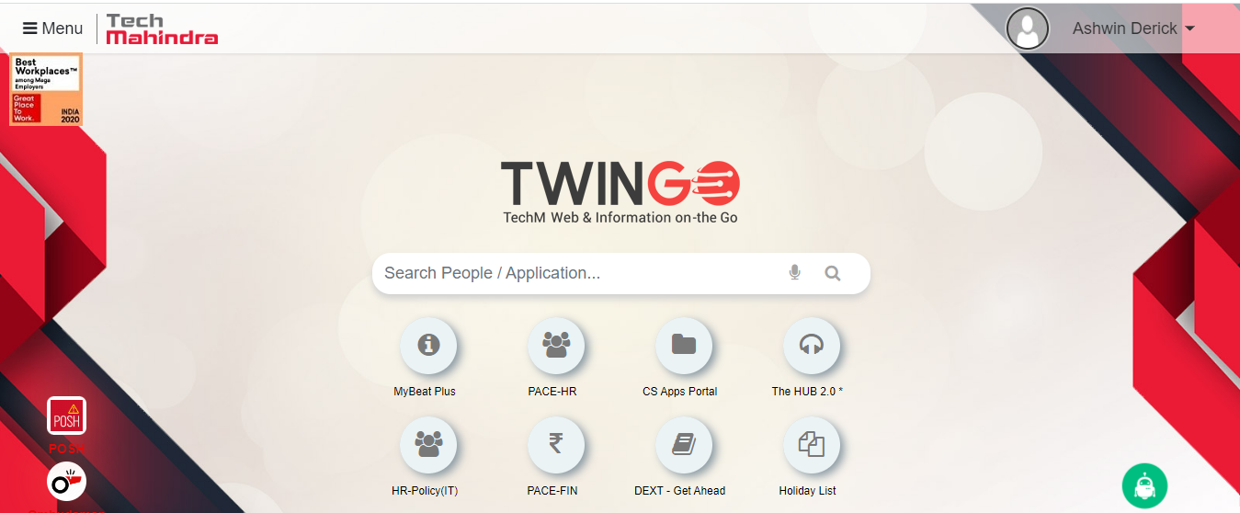
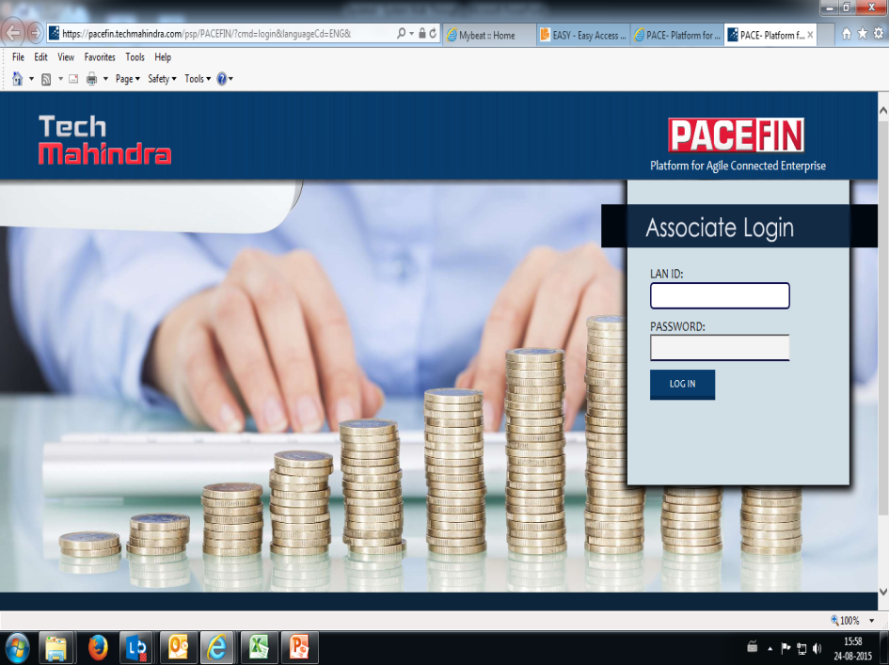
SYSTEMS WALK THROUGH

Slide 3

Contents to overview…
My Beat Plus
Twingo
PACE HR
PACE FIN
Human Resources Portal
CS
HelpNxt.Now Support Page

Slide 4
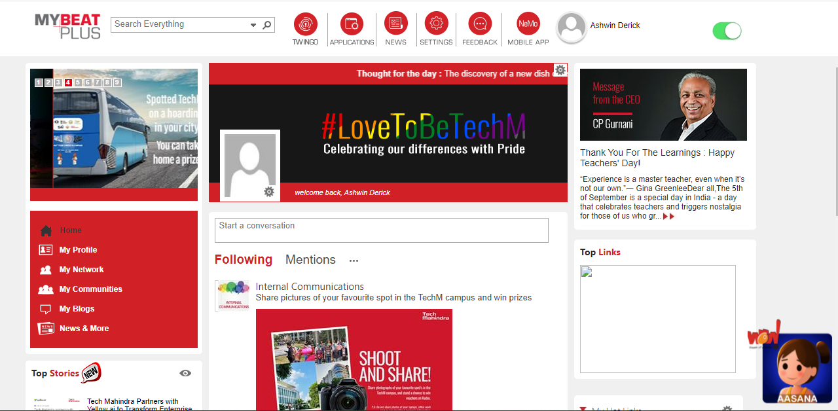
My Beat plus provides links to systems & other portals.
http://MyBeatplus.TechMahindra.com https://MyBeatplus.TechMahindra.com

Slide 5
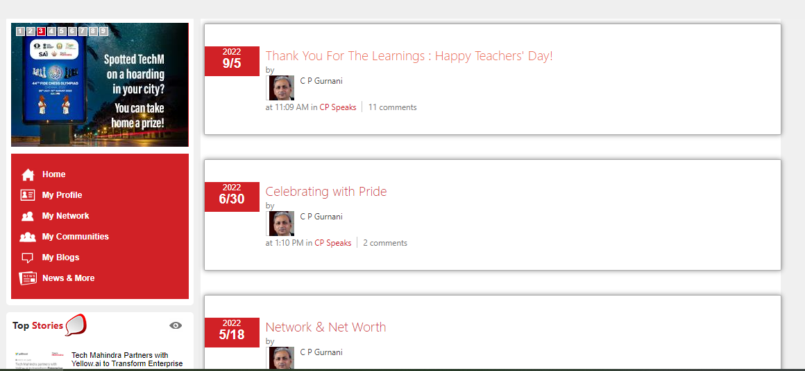
CEO’s BLOG

Slide 6
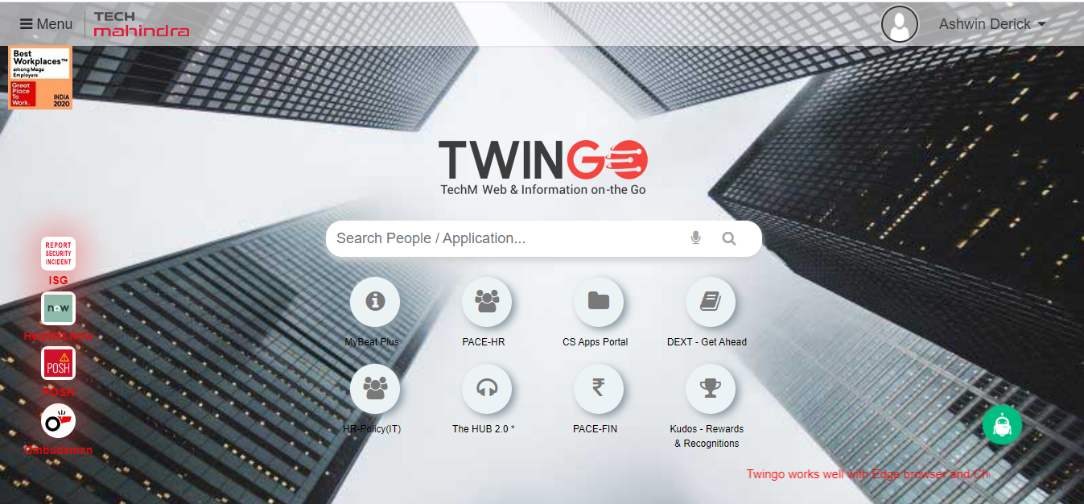
TWINGO
https://twingo.techmahindra.com/Twingohome.aspx

Slide 7
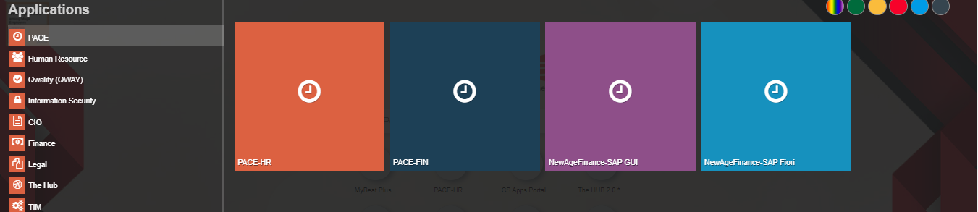
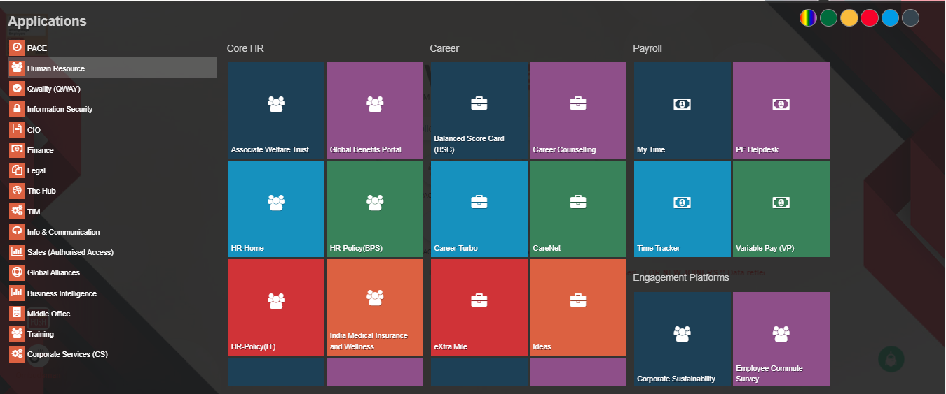
PACE → PACE-HR & PACE-FIN
HUMAN RESOURCE

Slide 8
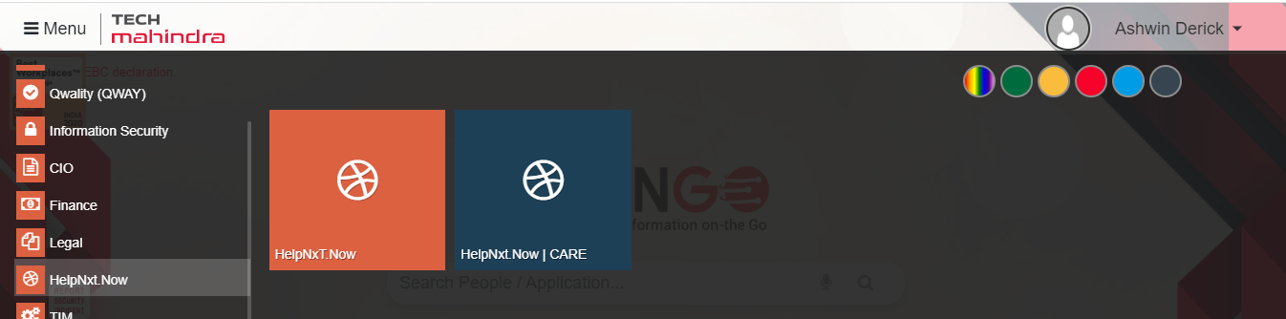
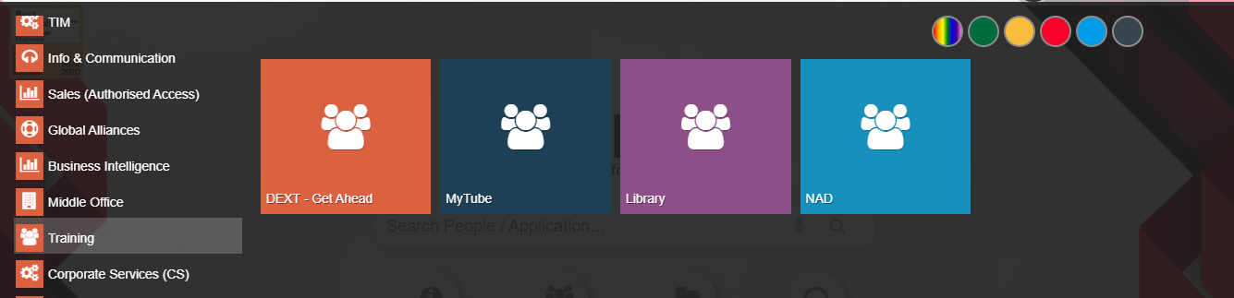
HelpNxt.Now
TRAINING → DEXT – Get Ahead

Slide 9
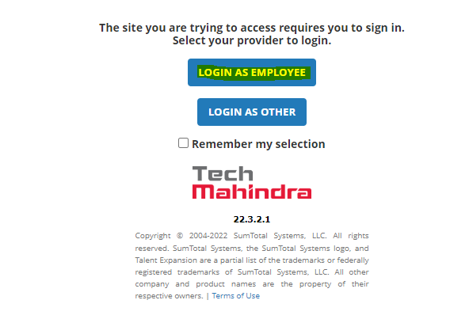
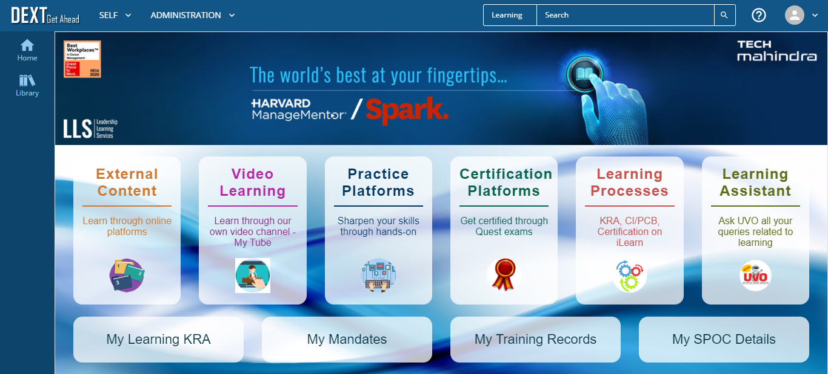
TRAINING → DEXT – Get Ahead

Slide 10
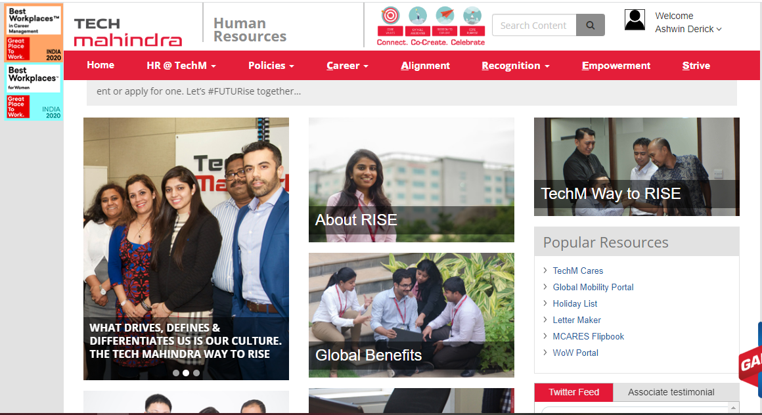
Human Resources (HR)
https://hr.techmahindra.com/index.aspx

Slide 11
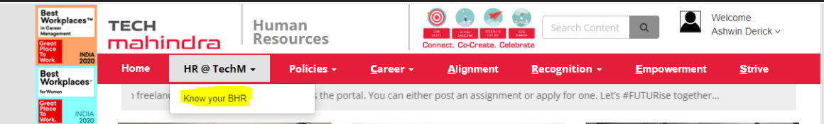
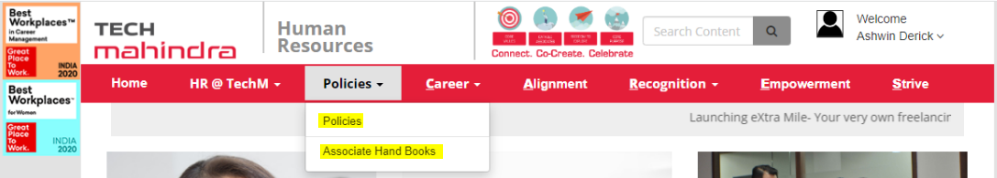
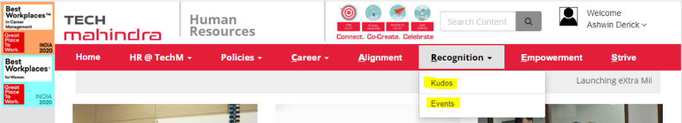
Know your BHR
Policies
Recognition

Slide 12
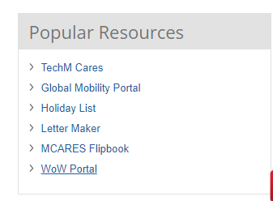
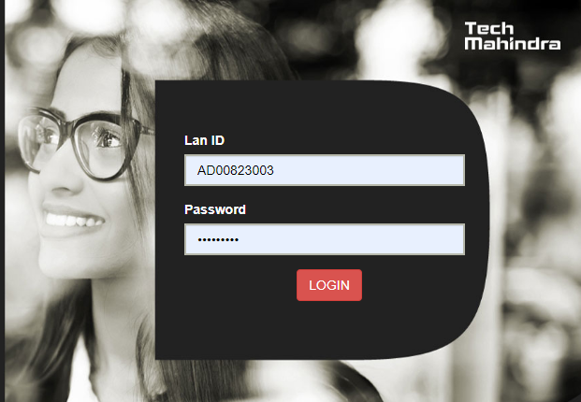
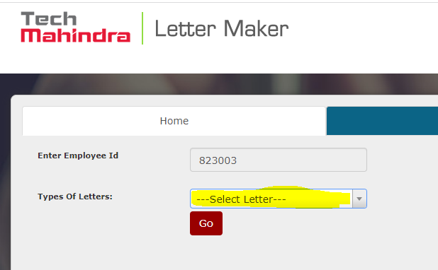
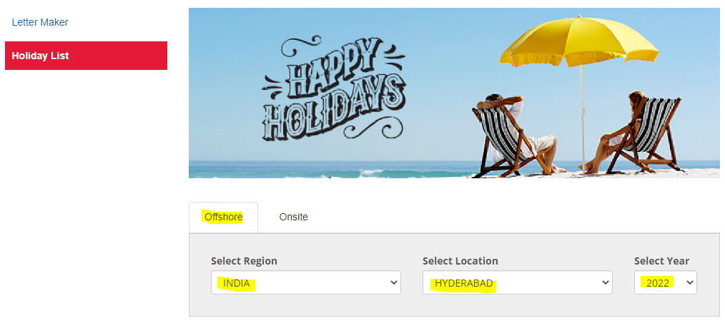
Holiday List & Letter Maker

Slide 13
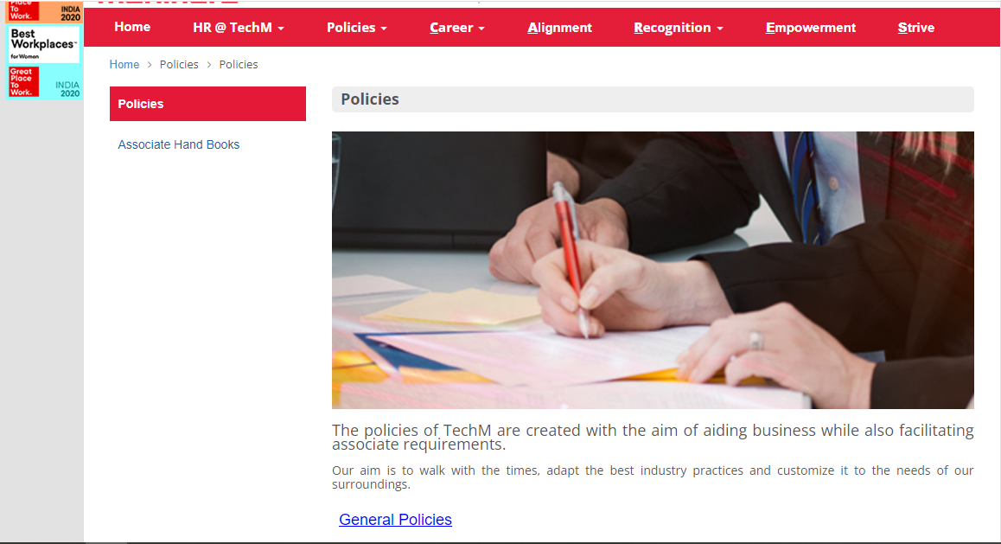
HR-Policy

Slide 14
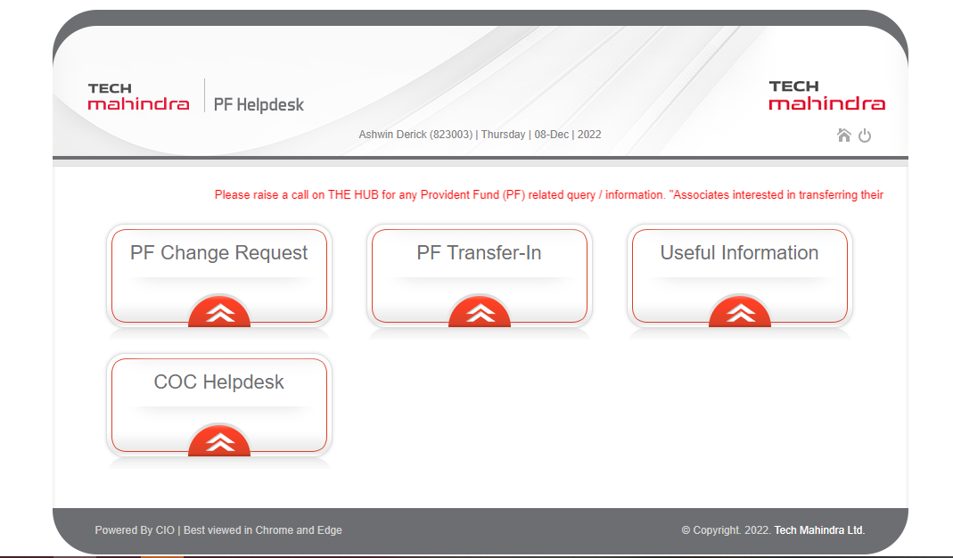
PF Helpdesk

Slide 15

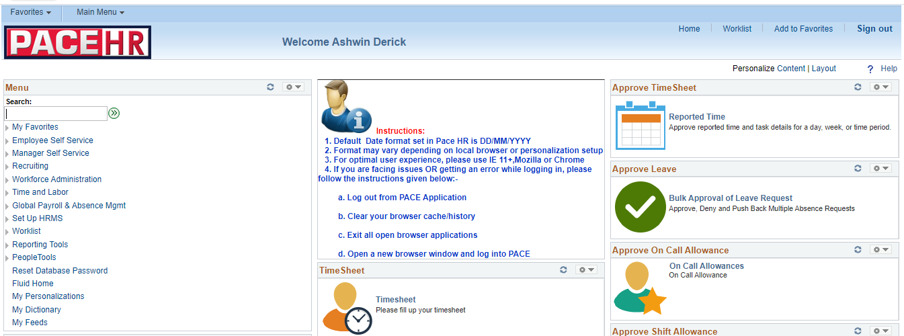
PACE-HR

Slide 16

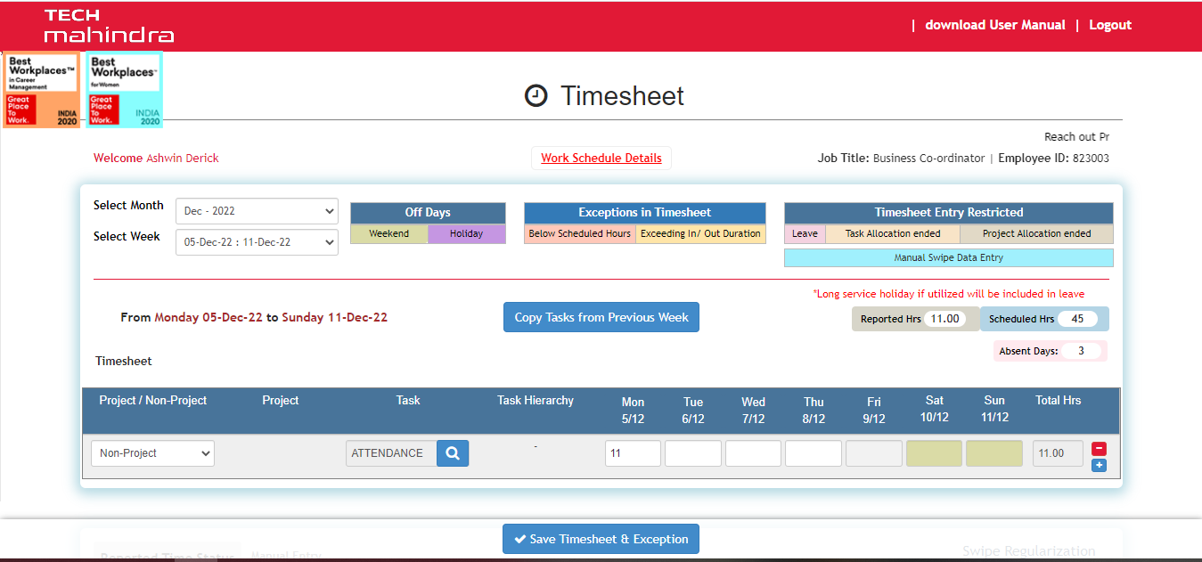
PACE (HR) – Fill Timesheet

Slide 17
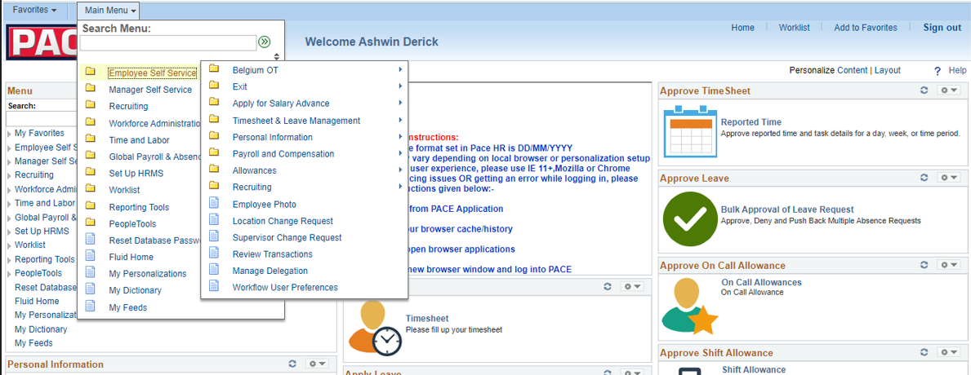
PACE HR → Employee Self Service

Slide 18
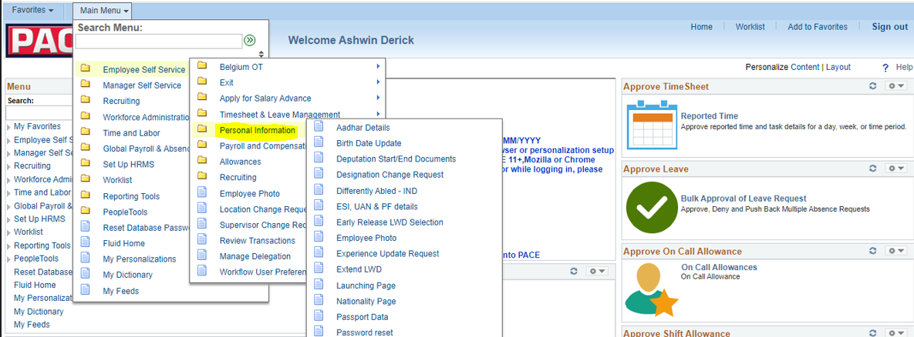
Employee Self Service → Personal Information

Slide 19
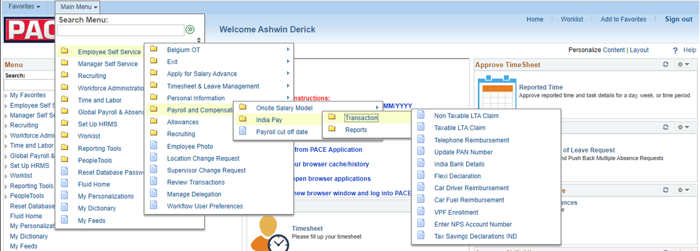

Employee Self Service -> Payroll & Compensation -> India Pay

Slide 20
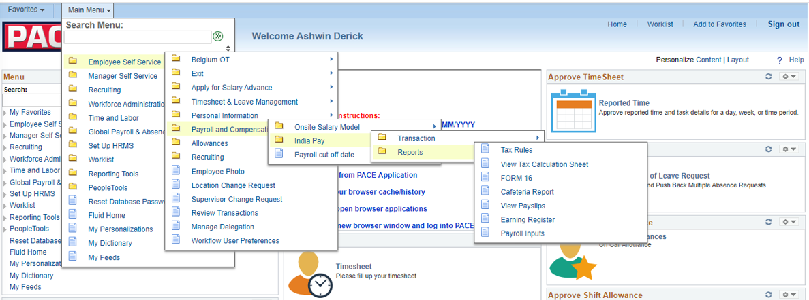
Employee Self Service → Payroll & Compensation → India Pay → Reports

Slide 21
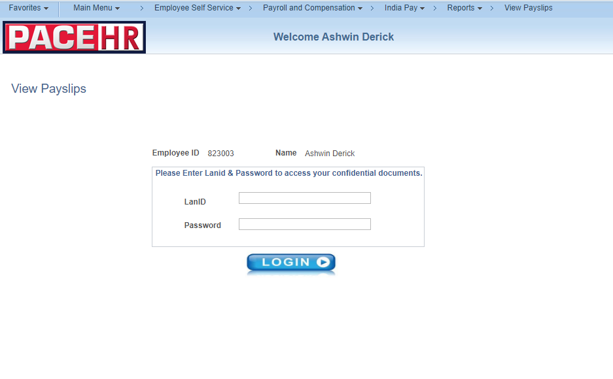
View Pay Slips

Slide 22
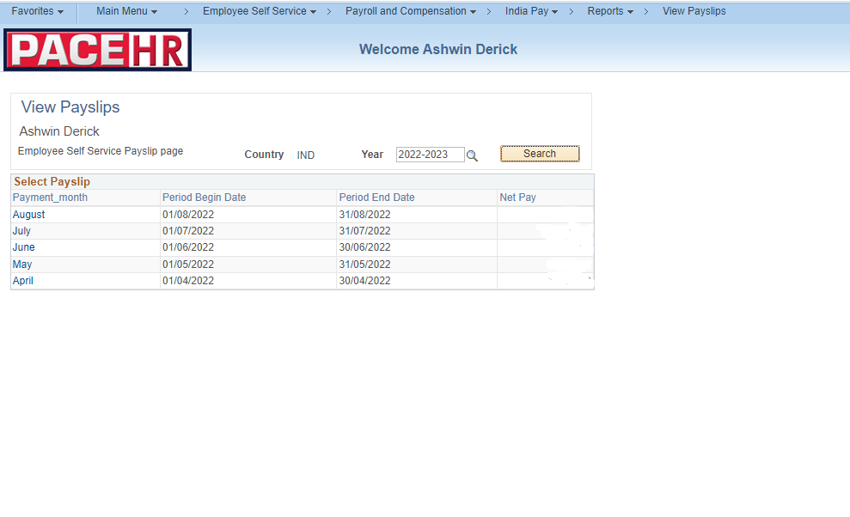
View Pay slips

Slide 23
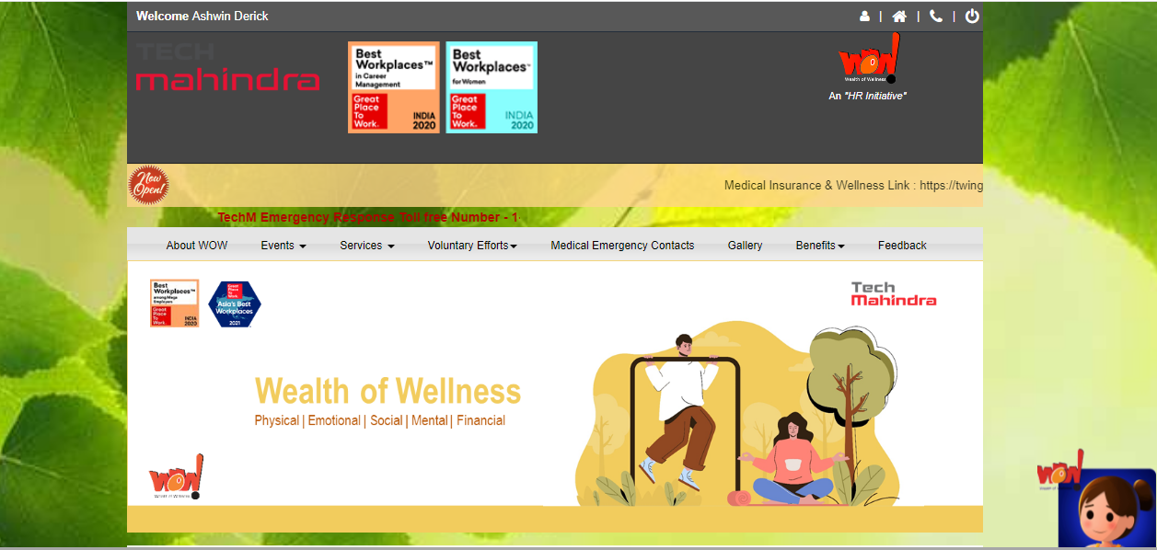
WOW - Connect to Wellness Portal

Slide 24

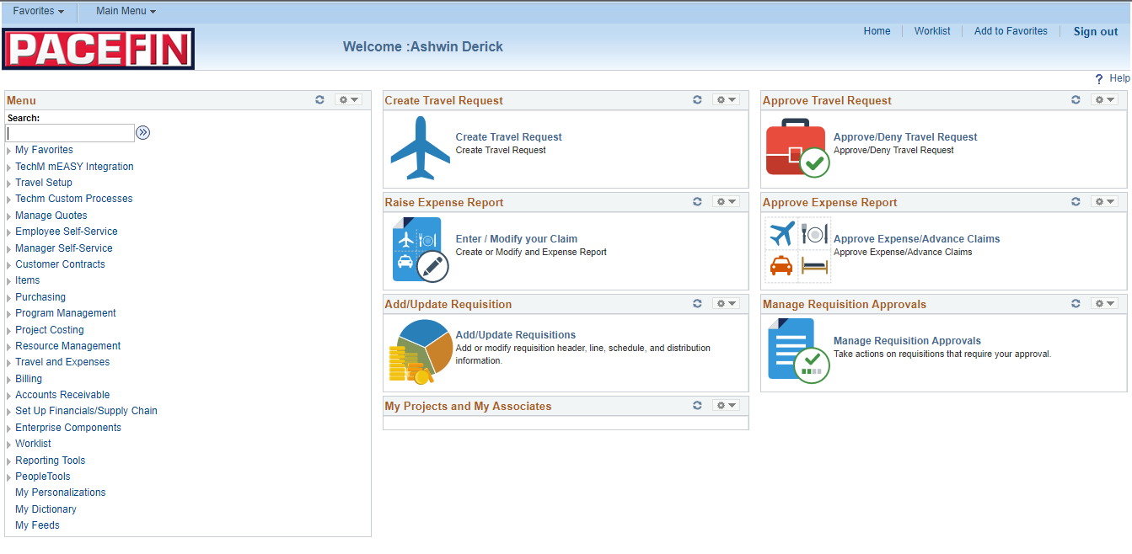
PACE FINANCE

Slide 25

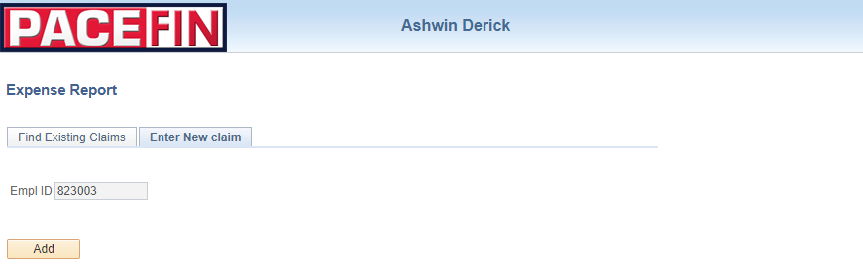
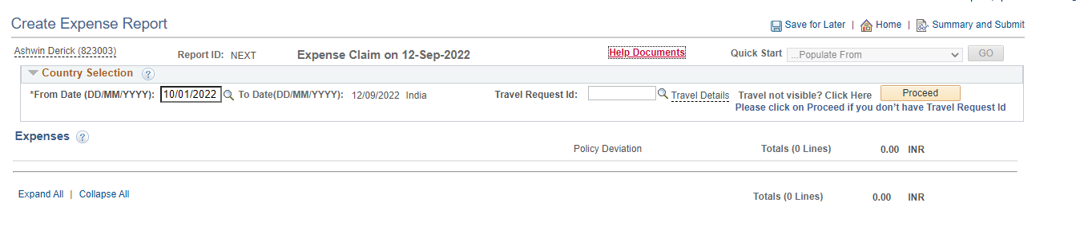
Creation of Expense Report

Slide 26

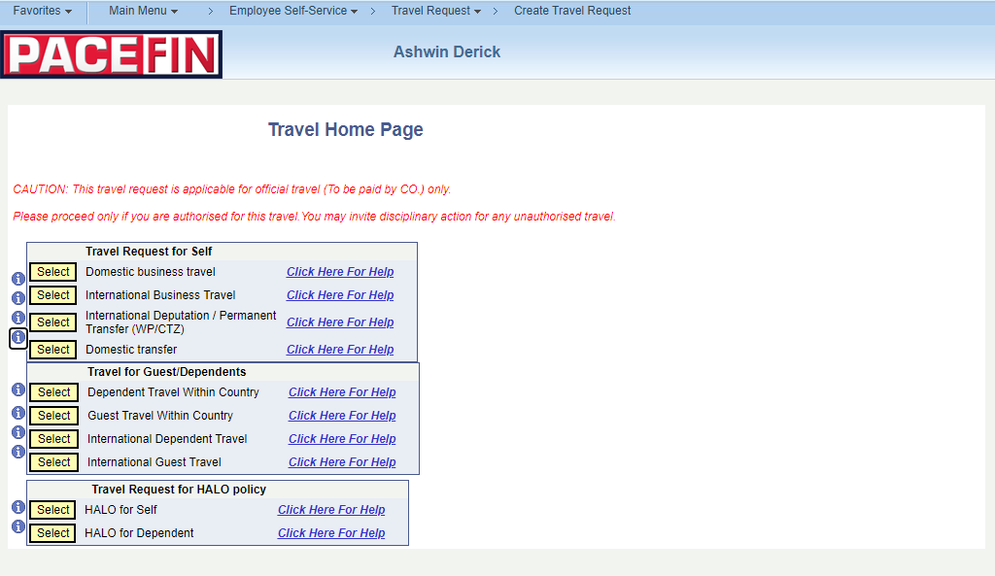
Create Travel Request
Select Domestic Travel Request / International Travel Request > Fill in all the required details > Submit

Slide 27
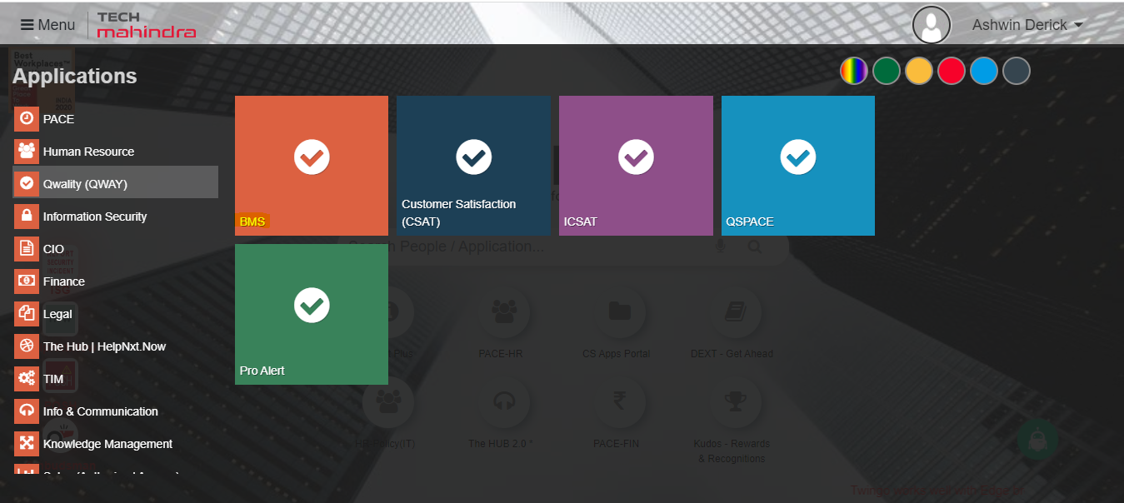
Quality (Qway) → BMS

Slide 28
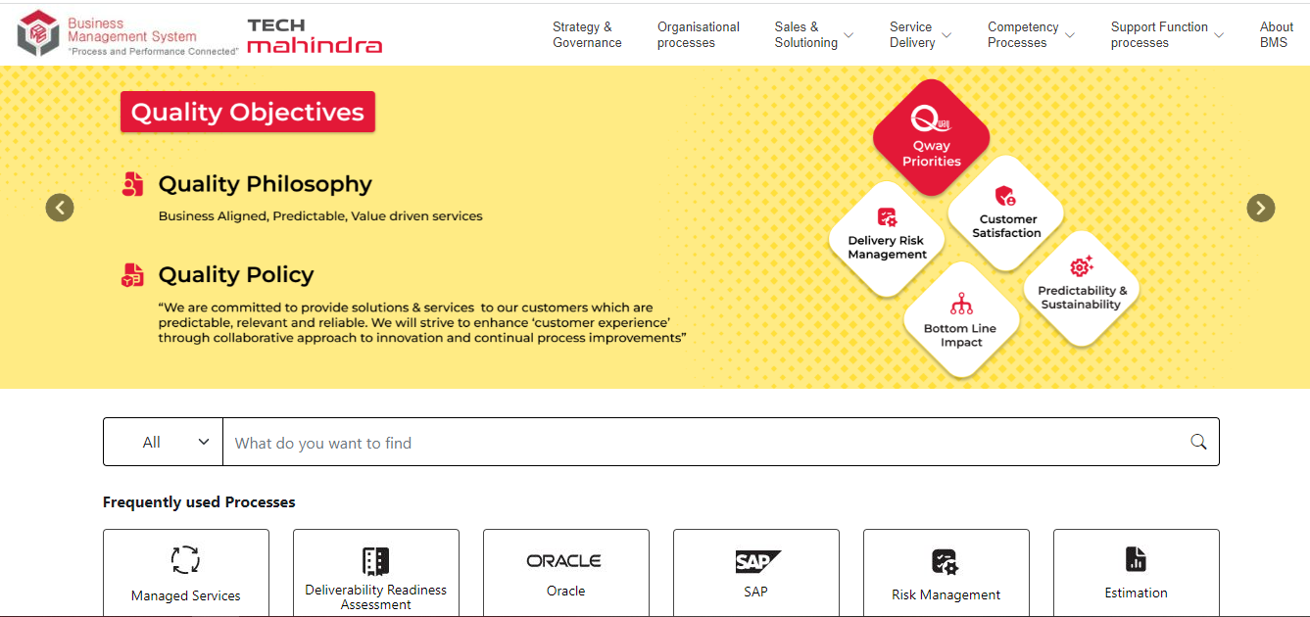
Business Management System (BMS)

Slide 29

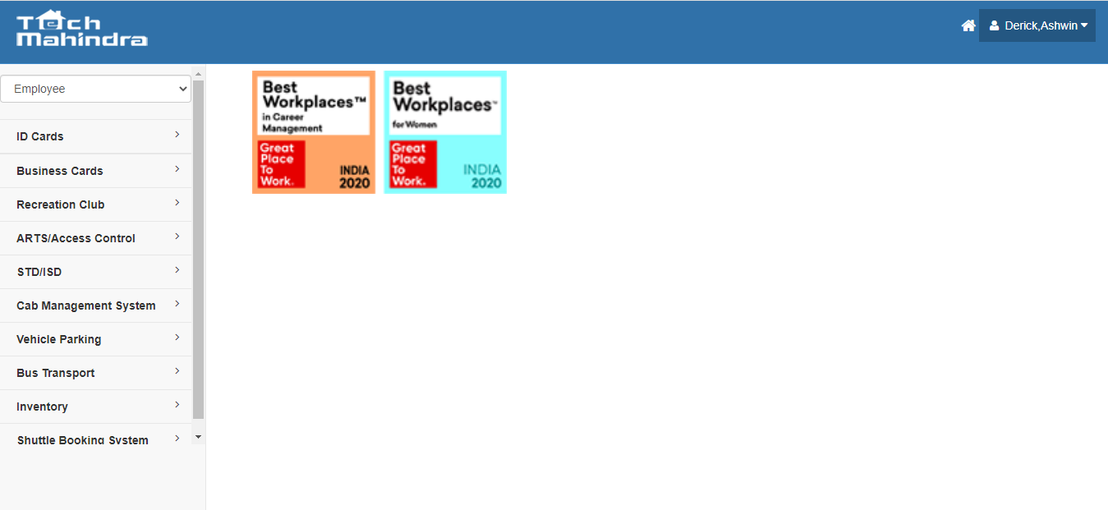
Corporate Services (CS)
Under Corporate services tool, associates can raise requests pertaining to Bus facility, Business Cards, STD/ISD code, Shuttle booking request can be raised.

Slide 30
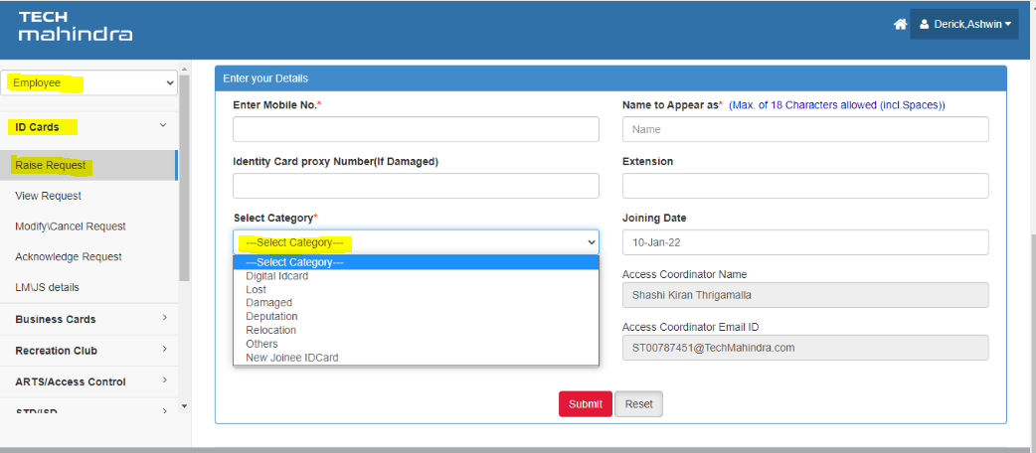
Digital ID Card & New Joiner Physical ID
Ensure to upload white background photograph while raising request for Digital ID Card & New Joiner Physical ID Card under required category.

Slide 31
Once your Digital ID Card request is approved, you may download the mEasy app as per instructions below:
1. For android phones, go to Play Store and download the Apps - mEASY, myHub, and NeMo
2. To install mEASY iPhone app, visit the link https://apps.techmahindra.com/ on iPhone Safari browser.
3. Should you have any challenge, please write to CIO.Mobility@techmahindra.com
Once your New Joiner Physical ID Card request is approved, you may visit office and collect the ID Card & Access Card from the HUB ID Card Team. Note: ID Card / Access Card cannot be shipped to your address. It must be collected only from office.

Slide 32

HelpNxt.Now Ticket Tool
TWINGO → HelpNxt.Now → HelpNxt.Now
Scan these QR Codes for mobile App Download. Provide "https://helpnxt.techmahindra.com" in Instance Address field and proceed with authentication.

Slide 33
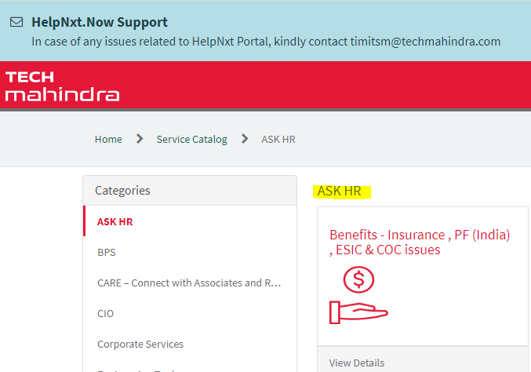
Ask HR For Benefits - Insurance, PF (India), ESIC & COC issues, Claims (ERA), Data Privacy (PI / SPI / GDPR), KUDOs - Rewards & Recognition, Learning systems ( LLS, TLS), Mobility ( Business travel & Deputation & Group transfers), New Hire (Joining Bonus, NP Pay, Data correction & Referral), Payroll Issues ( Leave, Timesheet & Salary) and Separations (Resignation, FFS & Exit Related).

Slide 34
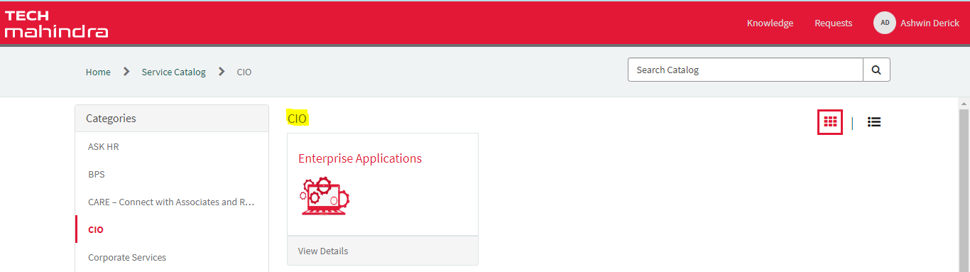
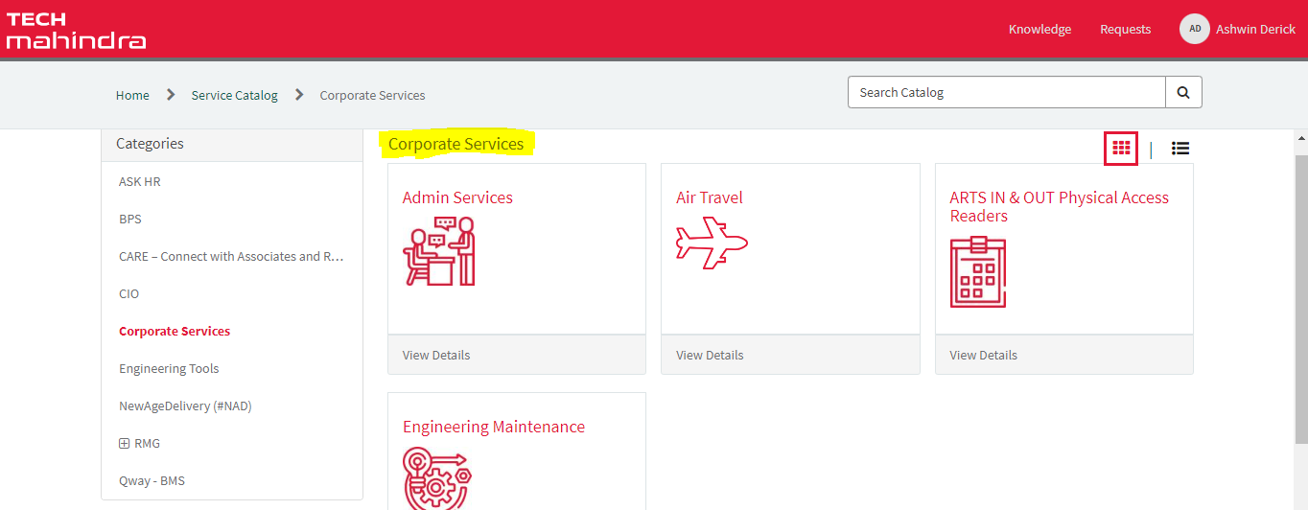
CIO – For Access Request, System / Portal issues.
Corporate Services - For Admin Services, Air Travel, ARTS IN & OUT Physical Access Readers, Engineering Maintenance.

Slide 35
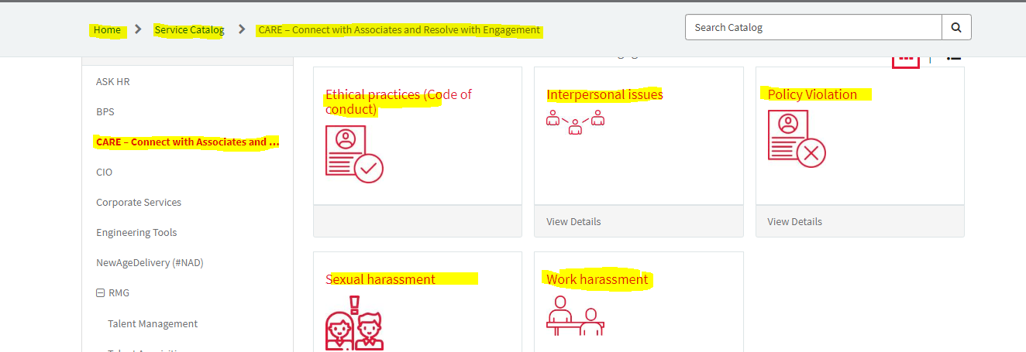
CARE – Connect with Associates and Resolve with Engagement: Ethical practices (Code of conduct, Interpersonal issues, Policy Violation, Sexual harassment, Work harassment.

Slide 36

MS Teams and MS Outlook access for mobile device
https://helpnxt.techmahindra.com
MS Teams mobile category: HelpNxt Home → Service Catalog → ISG → Service Desk (CESP) → MS Teams
MS outlook on mobile: HelpNxt Home → Service Catalog → ISG → Service Desk (CESP) → Mail Box (Outlook/Webmail) → SVC 034-MAM Enrollment Request.
In case of any issues, kindly contact HelpNxt.Now Support timitsm@techmahindra.com

Slide 37
Thank you
Visit us at www.techmahindra.com

